Slide 1
Student services tracking system
JAVA
UI
</>
Dart
UX
2023-2024

Slide 2


National Egyptian E-Learning University
Faculty of Computer & Information Technology
Eng. Dalia Masoud
Under Supervision of:
Dr. Khaled Wassef
Professor in Computer and Information Technology Assiut University and
Egyptian E-Learning University
Teacher Assistant in Computer and Information Technology In
Egyptian E-Learning University

Slide 3
Table of contents:
Introduction --------------------------------- 5
Project idea --------------------------------- 6
Problem, Solution --------------------------------- 7
Methodology --------------------------------- 8
Prototype --------------------------------- 17
The Features --------------------------------- 25
Use case Diagram --------------------------------- 29
Sequence Diagram --------------------------------- 30
ERD Diagram & Schema --------------------------------- 31
UI & UX for project --------------------------------- 32
Organization Report --------------------------------- 37

Slide 4
Student services tracking system
Team Names
ID
1
Kerelos Rafat Monier 2001284
2
Hedra Talat Hosny 2000429
3
Marina Medhat Weliam 2000528
4
Yassa Kamal Anwar 2001165
5
Marina Toman Hosny 2000711
6
Kerolos Yassa Roshdey 2000720
7
Abanob Mamdoh Ramzy 2000712

Slide 5
INTRODUCTION
Is a software application or information system designed to manage and streamline various services and processes related to students within an educational institution, and helps educational institutions keep track of, the system typically focuses on enhancing the overall student experience, improving administrative efficiency, and ensuring that students have access to the support and resources they need.
</>
HTML
C++

Slide 6
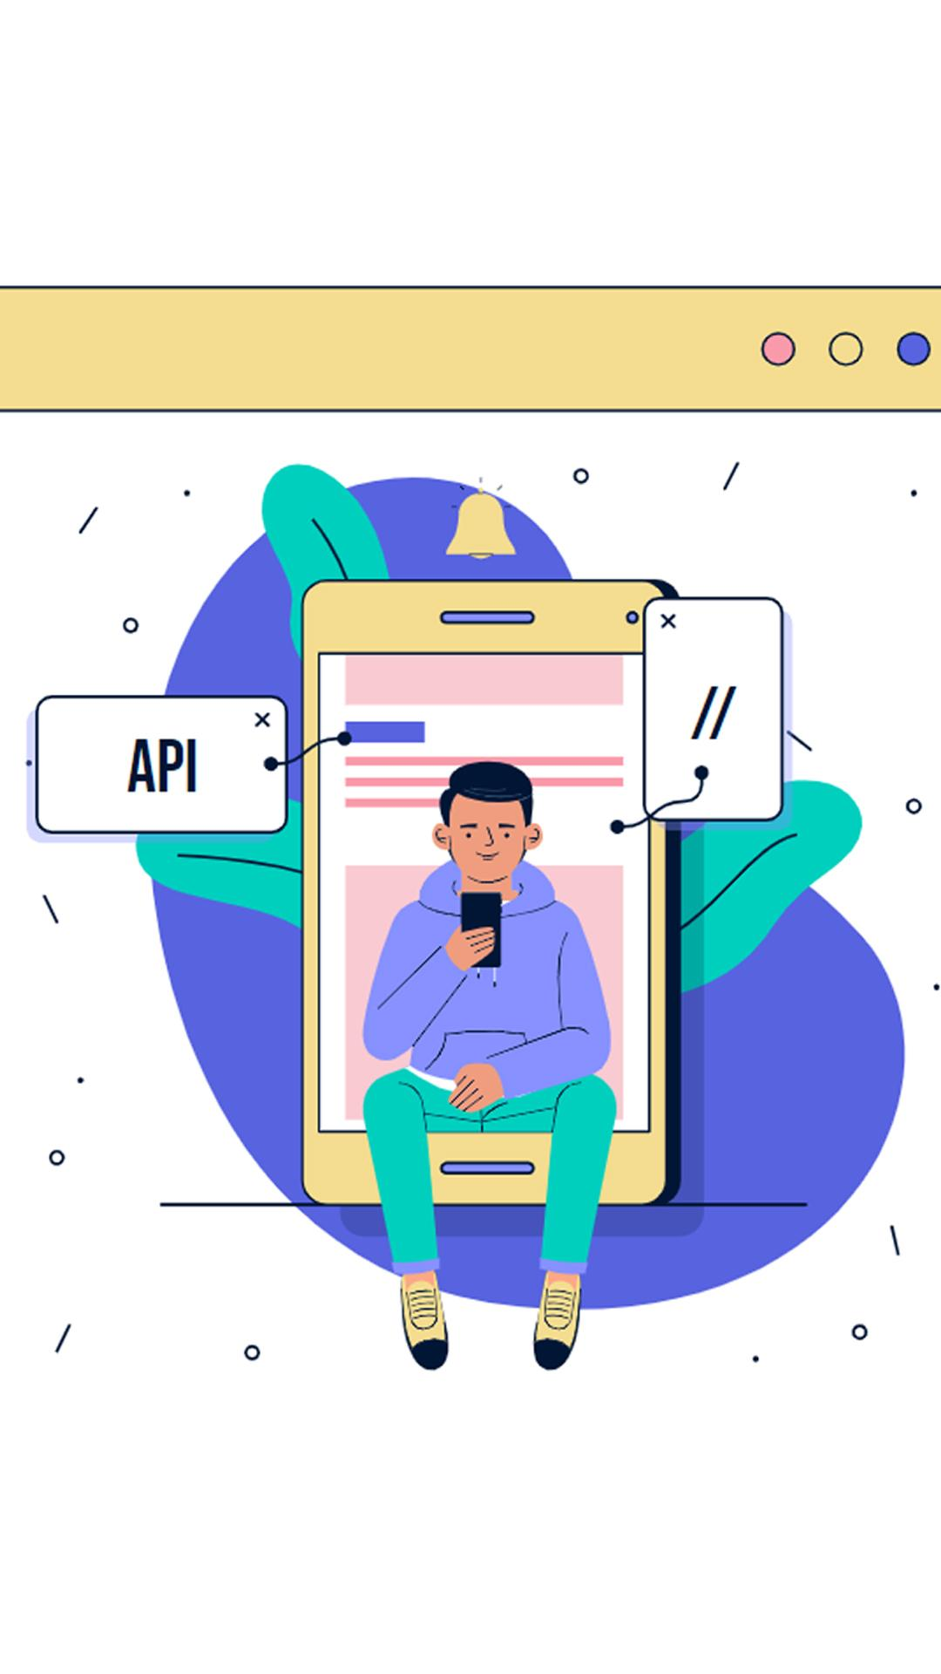
Project Idea
Purpose of project
Is a software application or information system designed to manage and streamline various services and processes related to students within an educational institution, and helps educational institutions keep track of, the system typically focuses on enhancing the overall student experience, improving administrative efficiency, and ensuring that students have access to the support and resources they need.

Slide 7

Project Idea
There is no university without a student service tracking system, like our university: EELU, but in this project there are some different features that make it easier for the student to interact with the college
online, and in our project, we will display all the features through this Application.
As it will contain the main components for the student, after he login into the application through his ID and password

Slide 8
Problem and solution
Problem
Lack of accurate knowledge of scholarships, competitions, and activities due to the large number of schedules within the college
It is difficult to obtain certificates from college affairs, and this causes significant time and effort disruption
The difficulty of going to college and the crowding of students at affairs when students register their subjects
Failure to solve students’ problems, organize their complaints, and respond to their questions in a quick time
You can obtain all types of certificates easily through this application
Receive all students’ questions and complaints and work to solve them as quickly as possible
Students can easily register subjects through the application
Ease of knowing about university scholarships and participating in all activities
Solution

Slide 9




Methodology
Front-end
In Front-end we will use flutter framework
Back-end
In Back-end we will use Node.js
Database
In Database we will use Mongo db
UI & UX
In UI & UX we will use Figma program

Slide 10
Methodology
Why use Flutter?
Programming with Flutter for application development offers numerous benefits, making it an attractive choice for developers. Here are some of the key advantages:
Flutter’s ability to deliver high-performance, visually attractive, and natively compiled applications for multiple platforms from a single codebase, along with its strong community support and powerful features, makes it a compelling choice for modern app development. These benefits result in faster development times, reduced costs, and an overall more efficient development process, leading to better end-user experiences

Slide 11
Methodology
Why use Flutter?
1. Cross-Platform Development
Single Codebase: Flutter allows developers to write one codebase that can run on multiple platforms, including iOS, Android, web, and desktop. This reduces development time and effort significantly.
Consistency: Ensures a consistent look and feel across different platforms.
2. Fast Development and Hot Reload
Hot Reload: Flutter’s hot reload feature allows developers to see the results of their code changes in real-time without restarting the app. This speeds up the development process and makes it easier to experiment and fix bugs.
3-High Performance
Native Performance: Flutter is compiled to native ARM code on both Android and iOS, providing high performance comparable to native apps.

Slide 12
Methodology
Why use Flutter?
4. Rich Set of Pre-Designed Widgets
Customizable Widgets: Flutter provides a rich library of customizable widgets for building complex UIs. Developers can easily create beautiful and highly customizable designs.
Material and Cupertino Libraries: Supports Material Design for Android and Cupertino (iOS-style) widgets, allowing for platform-specific aesthetics.
5. Strong Community and Support
Growing Ecosystem: A large and active community contributes to a rich ecosystem of packages and plugins, helping developers add functionality easily.
6. Integration Capabilities
Third-Party Plugins: Supports a wide range of third-party plugins for integrating various functionalities like databases, authentication, and cloud services.

Slide 13
Methodology
Why use Mongo db ?
MongoDB: is a popular NoSQL database known for its flexibility, scalability, and performance.
MongoDB’s flexibility, scalability, and performance make it an excellent choice for a wide range of applications, from small startups to large enterprises. Its ability to handle diverse data types, support for horizontal scaling, and ease of use enable developers to build and scale applications efficiently. The extensive ecosystem and robust security features further enhance its appeal for modern application development.

Slide 14
Methodology
Why use Mongo db ?
1. Schema Flexibility
Dynamic Schemas: Unlike traditional relational databases, MongoDB allows for flexible, schema-less data models. This enables the storage of data in varied structures, which can evolve over time without requiring changes to the database schema.
Easier Data Modelling: Developers can quickly adapt the data model to changing application requirements without needing extensive migrations.
2. Scalability
Horizontal Scaling: MongoDB supports horizontal scaling through sharding, which allows data to be distributed across multiple servers. This ensures the database can handle large volumes of data and high traffic loads
Load Balancing: Automatic load balancing across shards ensures even distribution of data and workload, enhancing performance.

Slide 15
Methodology
Why use Mongo db ?
3. Performance
High Throughput: MongoDB is designed for high write and read throughput, making it suitable for applications that require real-time data processing.
Indexing: Supports a variety of indexes and provides powerful querying capabilities to optimize performance for read-heavy operations.
4. Rich Query Language
Flexible Queries: Offers a rich, JSON-like query language that supports a wide range of query types, including ad-hoc queries, range queries, and text searches.
Aggregation Framework: Provides an aggregation framework for performing complex data processing and transformation operations on the server side.
5. Ease of Use
Developer-Friendly: MongoDB’s document-based data model is intuitive and aligns well with how developers think about and work with data in modern applications.

Slide 16
Methodology
Why use Node.js?
Node.js is a popular runtime environment that allows developers to use JavaScript for server-side scripting. It offers a range of benefits for building applications, making it a preferred choice for many developers.
Node.js offers a powerful and flexible environment for building a wide range of applications, from simple web servers to complex, real-time, data-intensive applications. Its performance, scalability, and rich ecosystem make it an excellent choice for modern application development, providing significant benefits in terms of speed, efficiency, and developer productivity

Slide 17
Methodology
Why use Node.js?
1. High Performance
Non-Blocking I/O: Node.js uses non-blocking, event-driven architecture, which allows it to handle multiple requests simultaneously without waiting for any operation to complete. This results in high throughput and efficient handling of concurrent operations.
2. Scalability
Event-Driven Model: Its event-driven, asynchronous nature makes Node.js well-suited for scalable network applications that require handling numerous simultaneous connections.
Microservices Architecture: Facilitates building applications with a microservices architecture, where services can be independently scaled and maintained.
3. Full-Stack JavaScript
Unified Language: Developers can use JavaScript for both client-side and server-side development, resulting in a more cohesive development process and code reusability.

Slide 18
Methodology
Why use Node.js?
4.Rich Ecosystem and Libraries
NPM : Provides access to a vast repository of open-source libraries and modules, simplifying the process of adding functionality to applications.
Active Community: A large and active community continuously contributes to the ecosystem, providing updates, tools, and support.
5. Real-Time Applications
Web Sockets and Event-Driven Architecture: Ideal for real-time applications like chat apps, gaming, and collaboration tools due to its ability to handle multiple events and maintain live connections efficiently.
6. Fast Development Cycle
Rapid Prototyping: The simplicity and flexibility of JavaScript, combined with Node.js’s extensive library support, enable rapid prototyping and development.

Slide 19
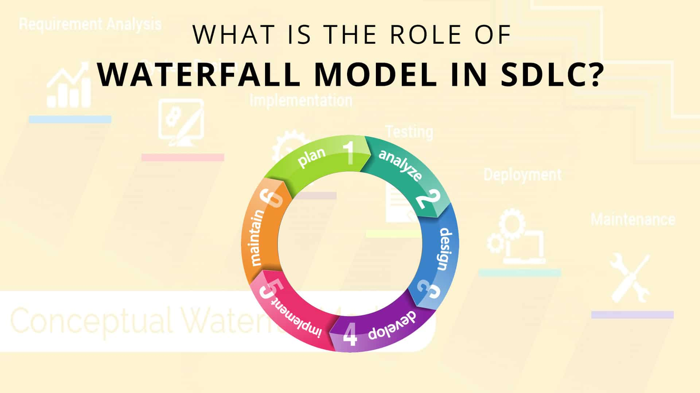
prototype
We use waterfall prototype:
A. Planning
B. Analysis
C. Design

Slide 20
prototype
D. Develop
E. Implement
F. Maintain

Slide 21
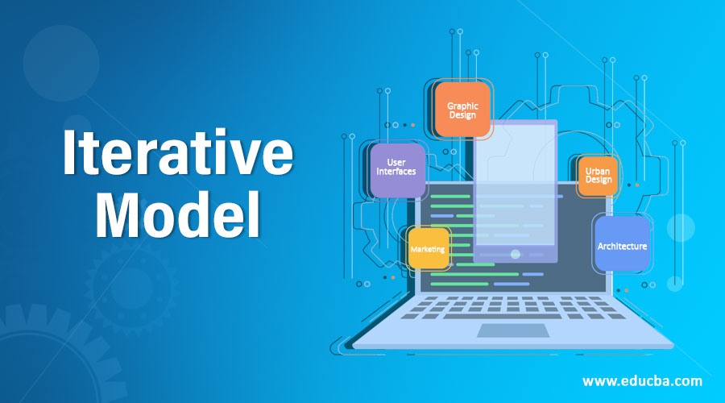
prototype
why use waterfall ?

Slide 22
prototype
The iterative methodology: is often used in software development, where it is also known as iterative and incremental development (IID) or agile development. In this approach, the software is developed through a series of iterations, with each iteration building on the previous one. Each iteration includes planning, design, implementation, testing, and evaluation, and feedback from each iteration is used to inform the next one

Slide 23
prototype
Early and Continuous Feedback:
Incorporating prototypes at various stages allows for early detection of issues and continuous feedback from stakeholders. This iterative feedback loop helps in refining requirements and design before full-scale development
Improved Requirement Understanding:
Prototyping helps in visualizing and clarifying requirements, reducing the risk of misinterpretation. Stakeholders can see and interact with a working model, which helps in refining and finalizing requirements effectively.

Slide 24
prototype
Reduced Risk:
potential risks can be identified and mitigated early in the development process. This reduces the likelihood of significant issues arising late in the project.
Enhanced User Involvement:
Users and stakeholders can interact with prototypes, providing valuable input and ensuring that the final product aligns more closely with their expectations and needs.

Slide 25
prototype
Planning: In this stage, the project goals and scope are defined, and the project team creates a roadmap for the project.
Design: The project team creates a prototype or a draft version of the product, which is then reviewed and refined based on feedback from stakeholders.
Development: The project team develops the product based on the refined prototype, and tests it to ensure it meets the project goals.
Evaluation: The project team evaluates the end product and the process used to develop it and identifies areas for improvement.

Slide 26
features of the application
Complaints: We will find a complaints section, which makes it easy for him to ask any question and learn anything about the university, and when he wants to complain about anything.
01.
02.
Course Registration: This makes it easy. The student should be able to register his courses without needing to go to college. This will save time and will also make it easier for the student if his address is far from the university.

Slide 27
features of the application
03.
Certificates: You can obtain certificates of all kinds, such as proof of registration, military certificate, certificate of results for each semester, transcript of grades, and graduation certificate.
04.
Scholarships: This is intended for some outstanding students only, and then the university provides some fully funded scholarships and semi-funded scholarships.

Slide 28
features of the application
05.
Activities: Where activities of all kinds, how to participate in them, and follow up on competitions with other universities.
06.
Notifications: Where a schedule of all appointments appears in the calendar, including lectures and sessions, as well as quizzes and office hours. When the deadline approaches, a message will arrive in the notifications so that the student remembers the deadlines well.

Slide 29
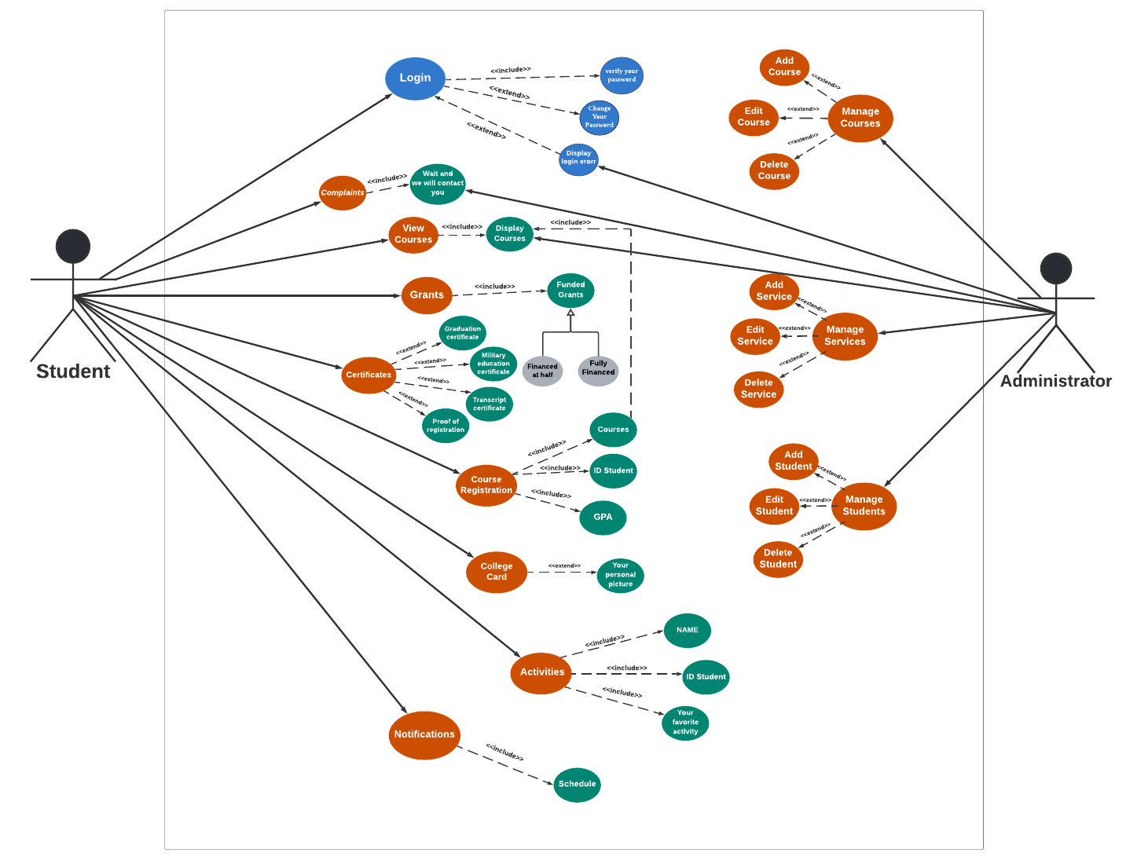
Use case DiAgram

Slide 30
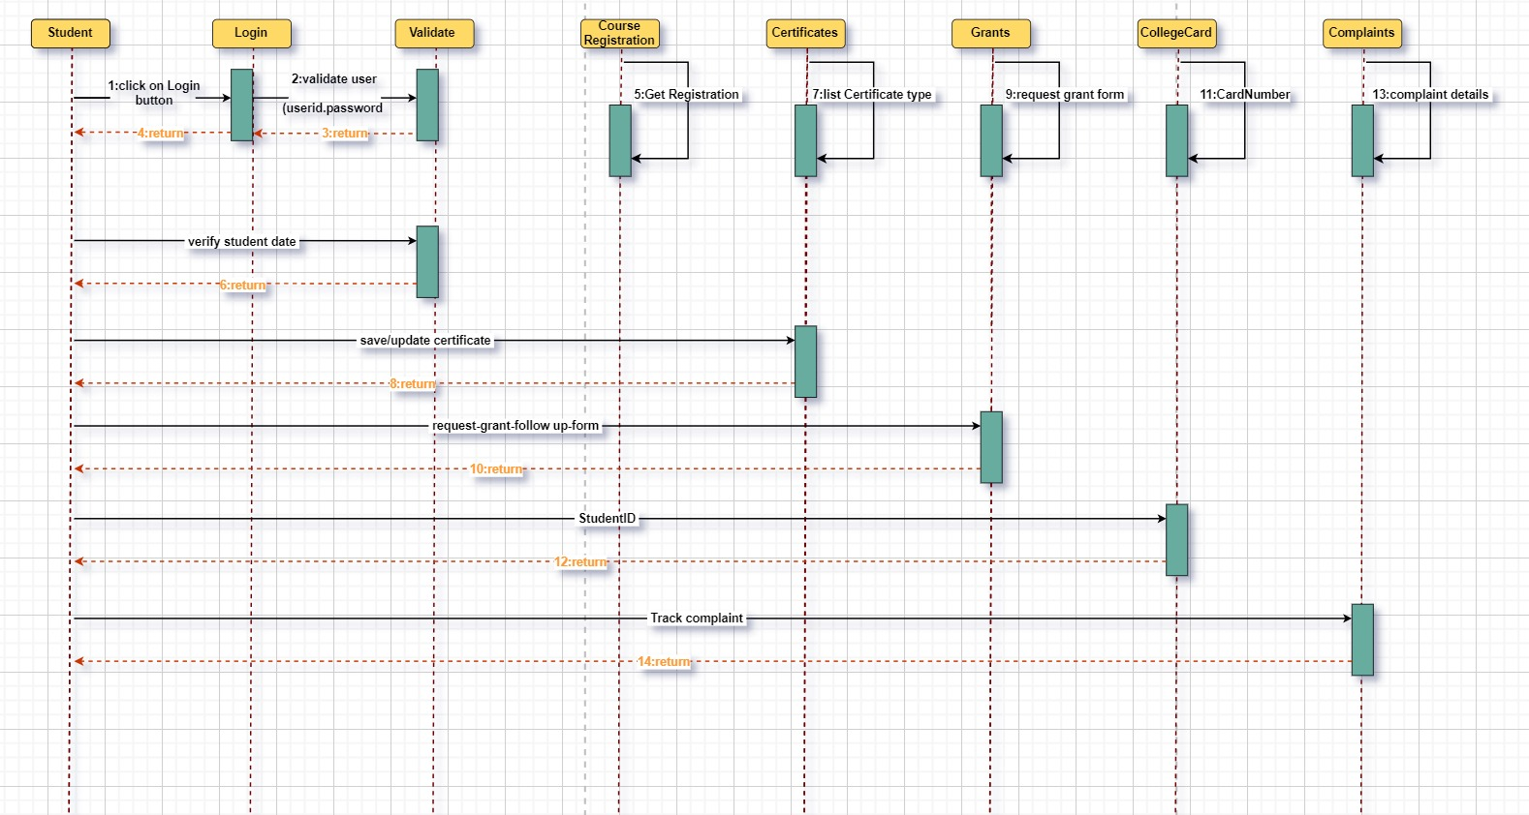
Sequence Diagram

Slide 31
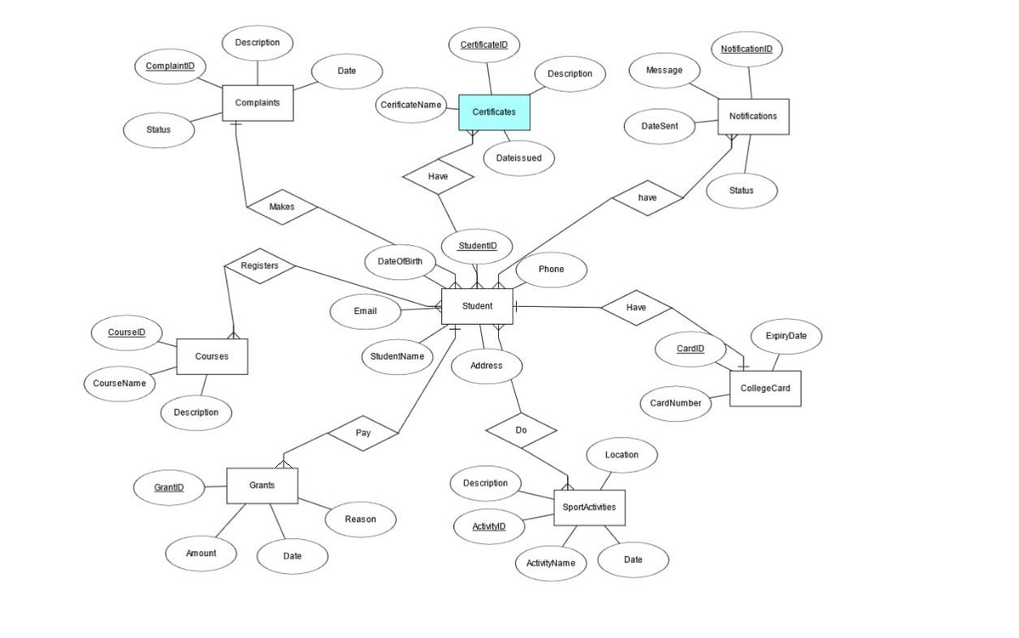
ERD DiAgram

Slide 32
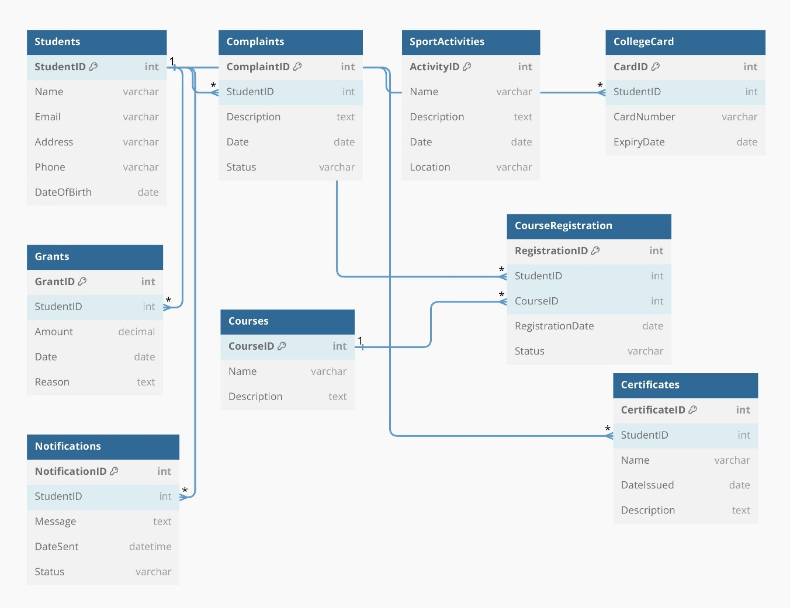
Schema DiAgram

Slide 33
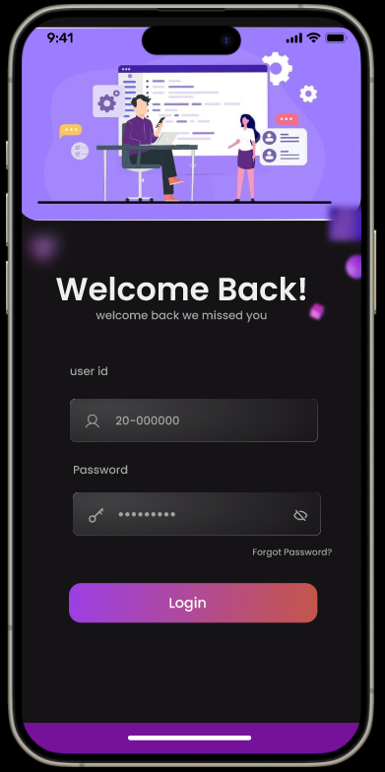
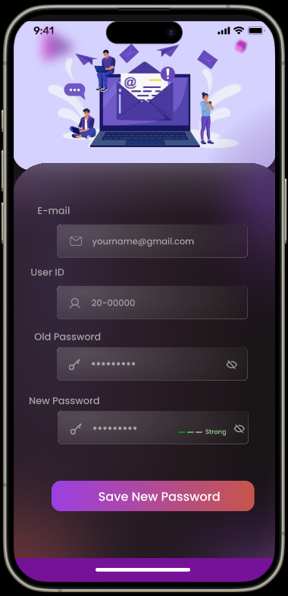
UI & UX for project
LOGIN
FORGET PASSWORD

Slide 34
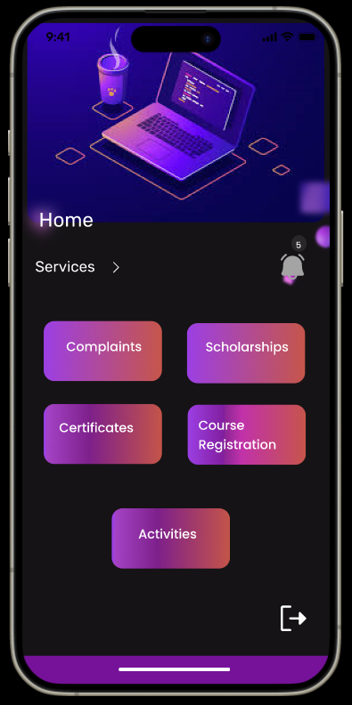
UI & UX for project
Home page

Slide 35
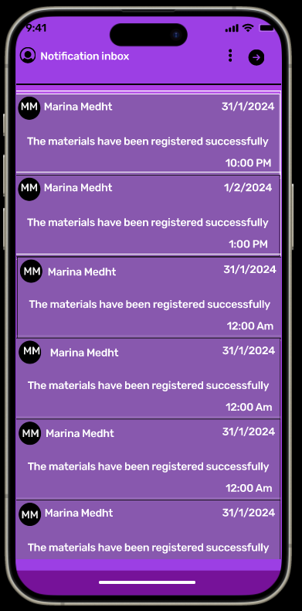

UI & UX for project
Notification

Slide 36
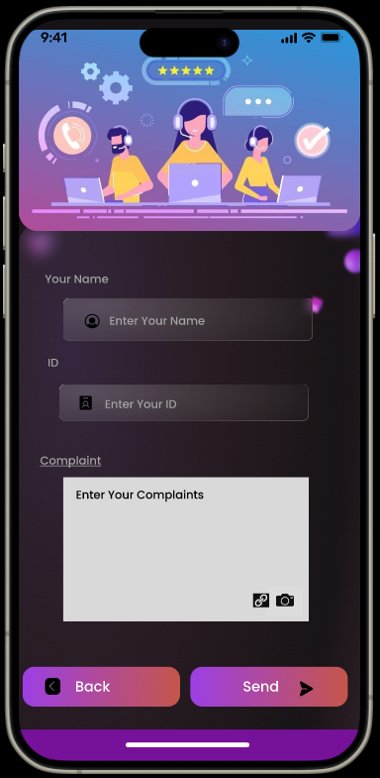
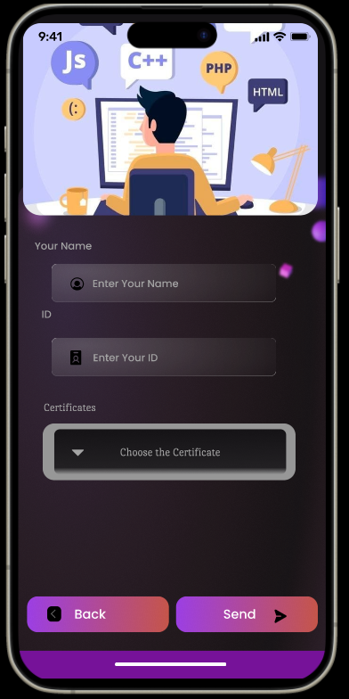
UI & UX for project
complaints
Certificates

Slide 37
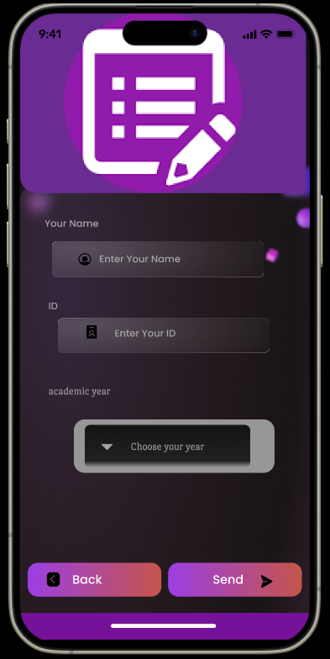
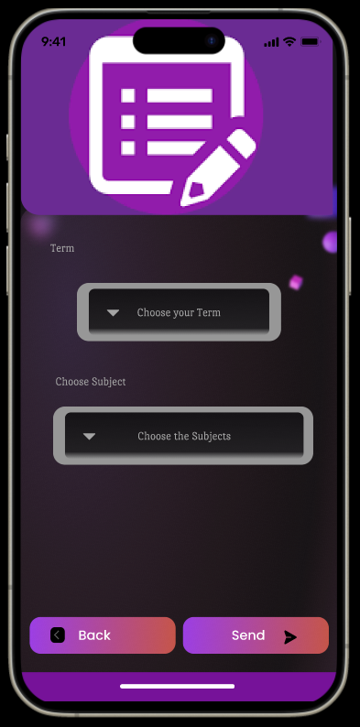
UI & UX for project
Course Registration

Slide 38
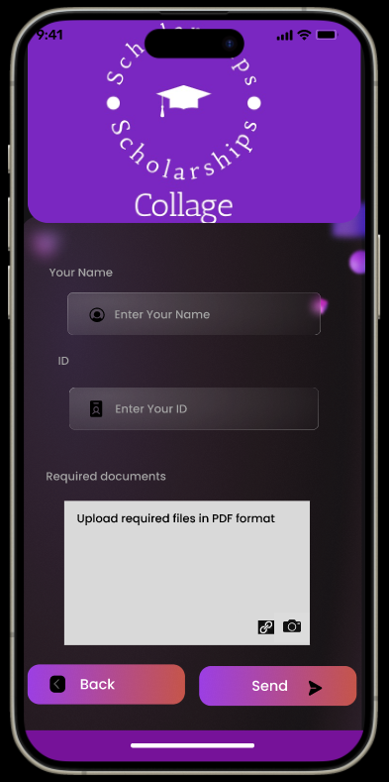
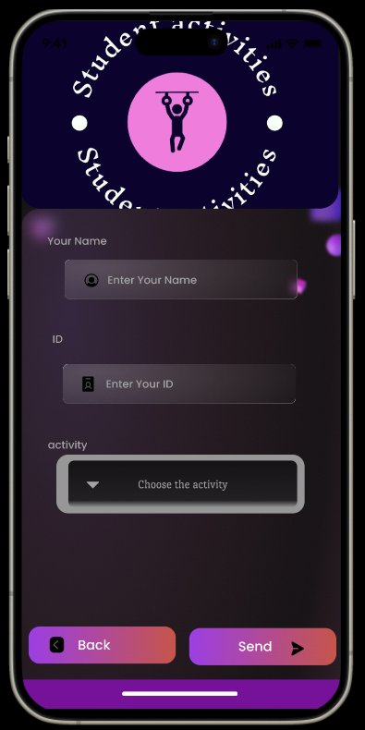
UI & UX for project
Scholarships
Activities

Slide 39

Implementation
Welcome
Page
Description:
On this page, the user will find two buttons: a button that takes him to the registration page, and a button that takes him to the login page.

Slide 40
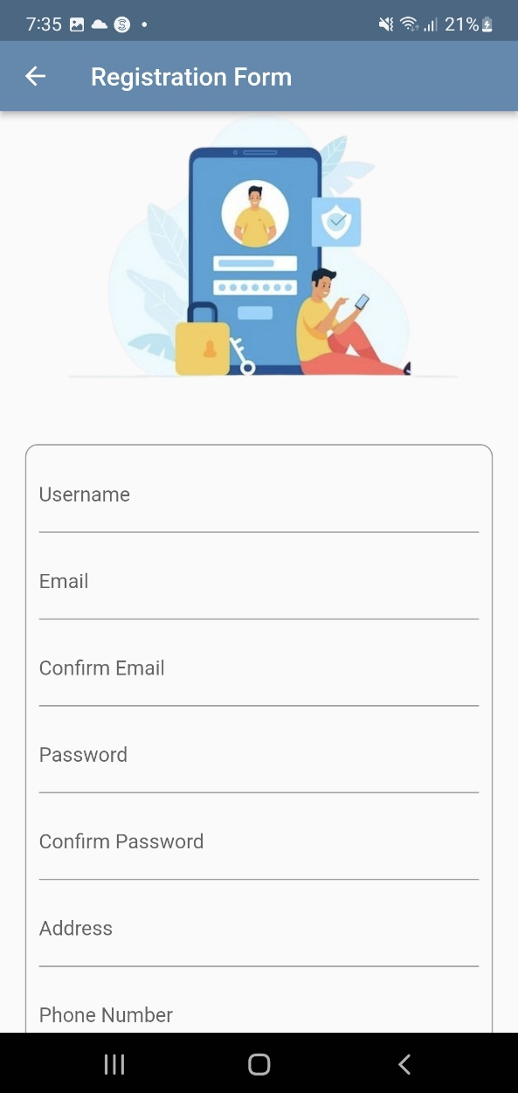
Implementation
Sign Up
Page
Description:
On this page, the user must enter all the data required of him to be able to enter the application and find all the services that are within the application.

Slide 41
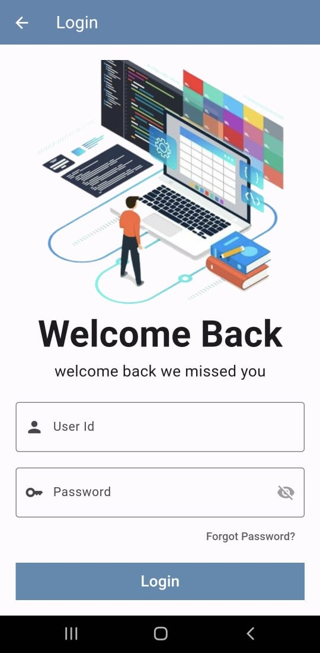
Implementation
Login
Page
Description:
On this page, the user must enter the required ID and password to be able to enter the application and find all the services within the application.

Slide 42
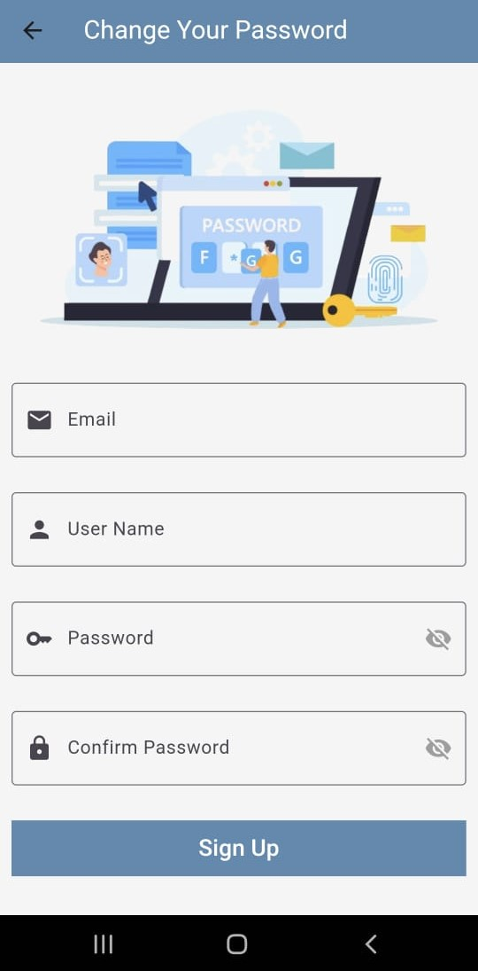
Implementation
Change password
Page
Description:
On this page, the user can change his password by entering his email, the user confirms it, then renews his new password and is able to enter the application.

Slide 43
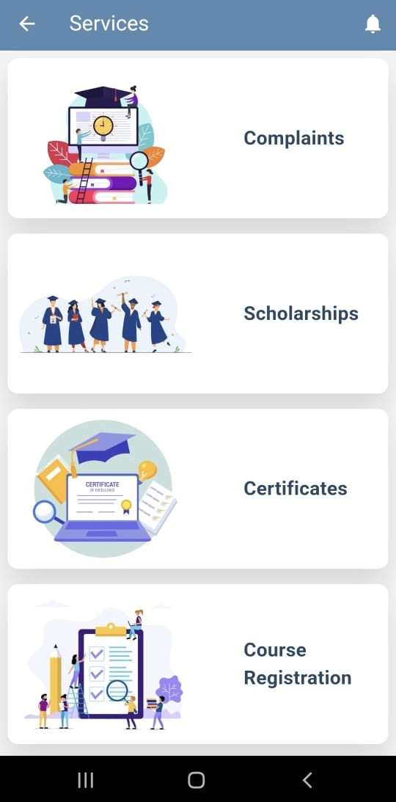
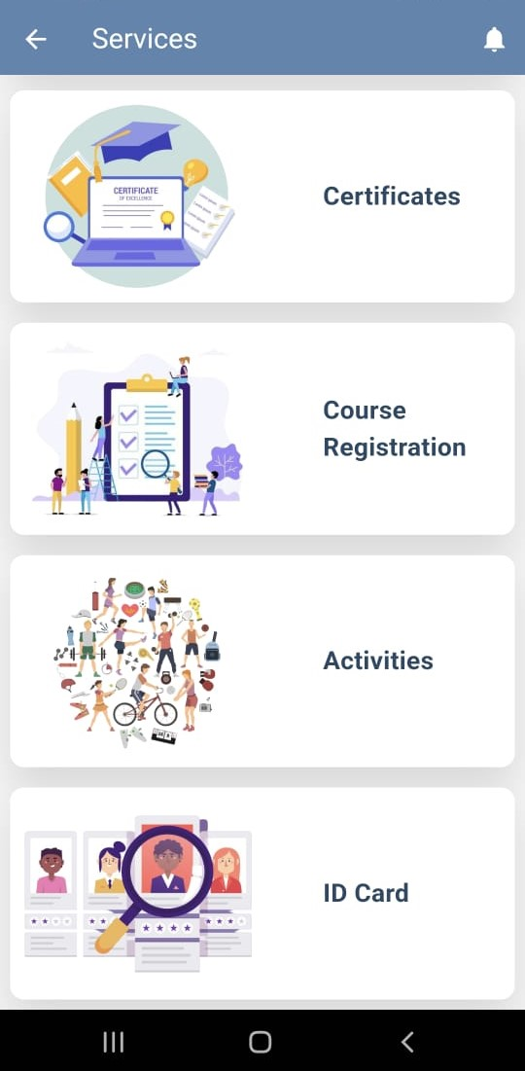
Implementation
Description:
On this page, the user will find all the features of the application to enjoy, choose what he wants from them, and continue with the rest of the features.
Home
Page

Slide 44
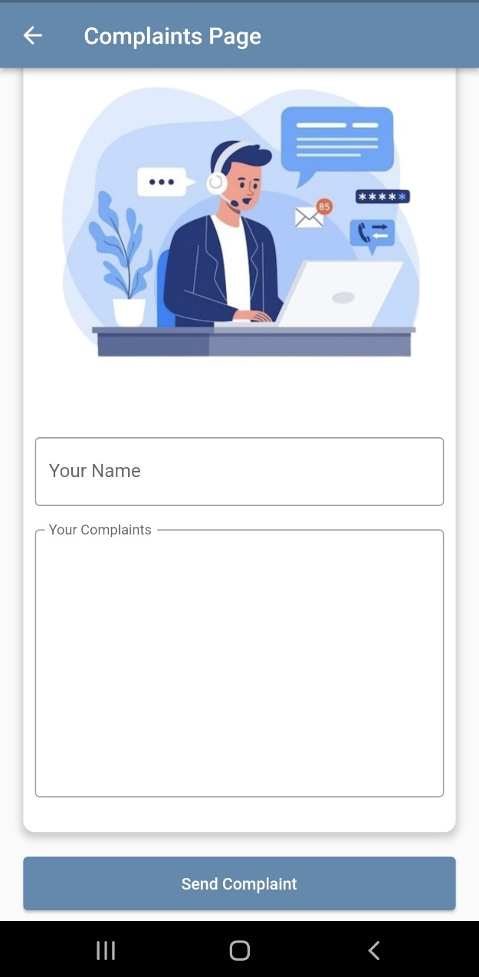
Implementation
Description:
On this page, the user can complain about anything that is bothering him inside the college, or he can ask and inquire about something, so he writes what he wants and presses the send button, so his message is delivered to the admin, and then he will meet her and respond to him as soon as possible.
Complaints
Page

Slide 45

Implementation
Description:
On this page, the user can find some scholarships offered by some universities around the world, but some of the scholarships will be under certain conditions, so the user must enter his name and his GPA and see the scholarships that will be available to him.
Scholarships
Page

Slide 46
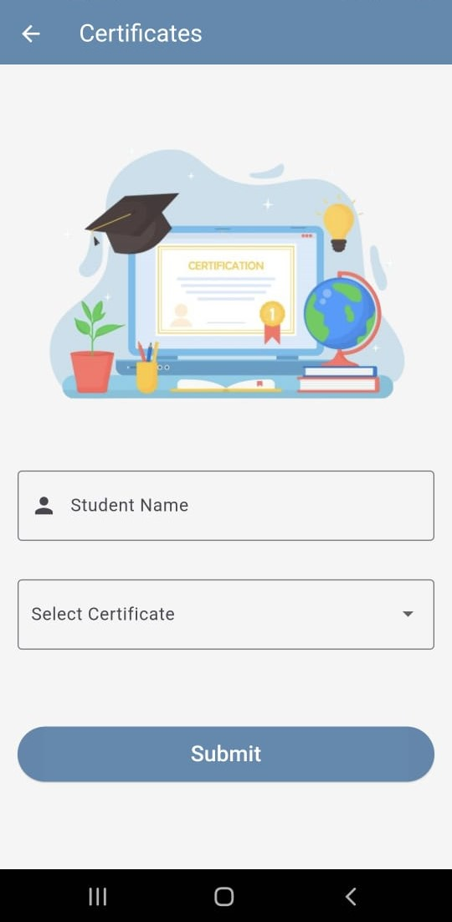
Implementation
Description:
On this page, the user can obtain certificates of all kinds, such as proof of registration, graduation certificate, results certificate for each semester, transcript of grades, and graduation certificate.
Certificates
Page

Slide 47
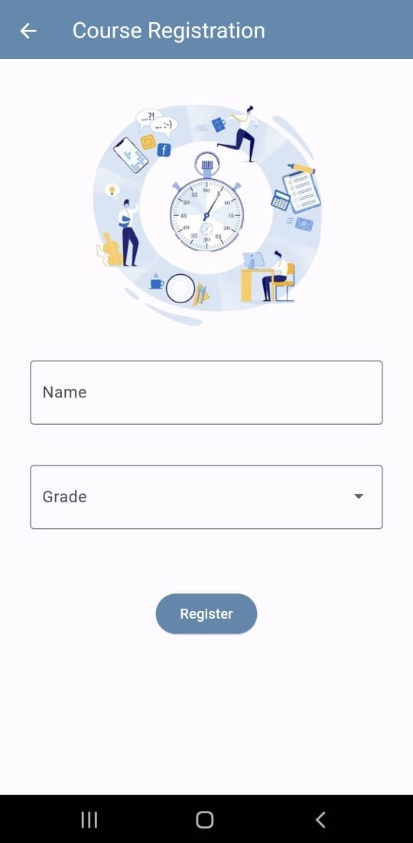
Implementation
Description:
This makes it easy. The student should be able to register for his courses without needing to go to college. This will save time and will also make it easier for the student if his address is far from the university
Course Registration
Page

Slide 48
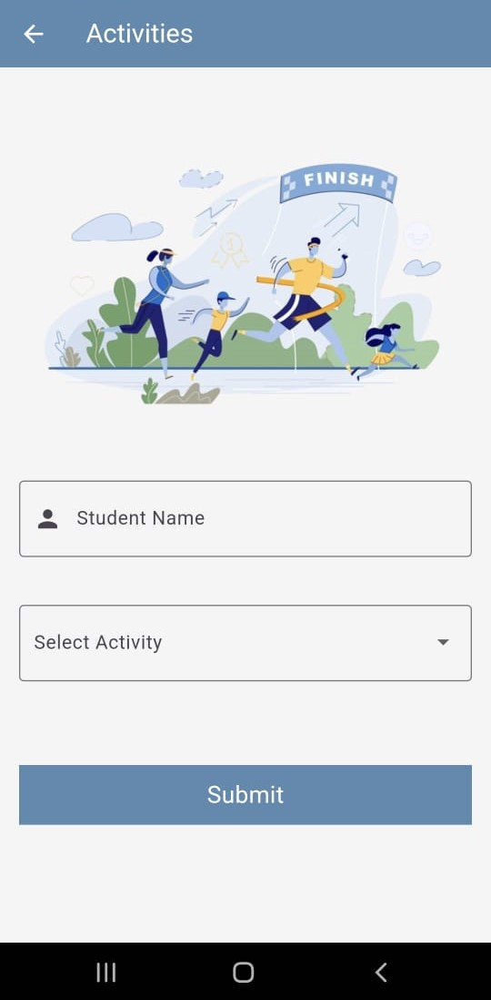
Implementation
Description:
Where activities of all kinds, how to participate in them, and follow up on competitions with other universities.
Activities
Page

Slide 49
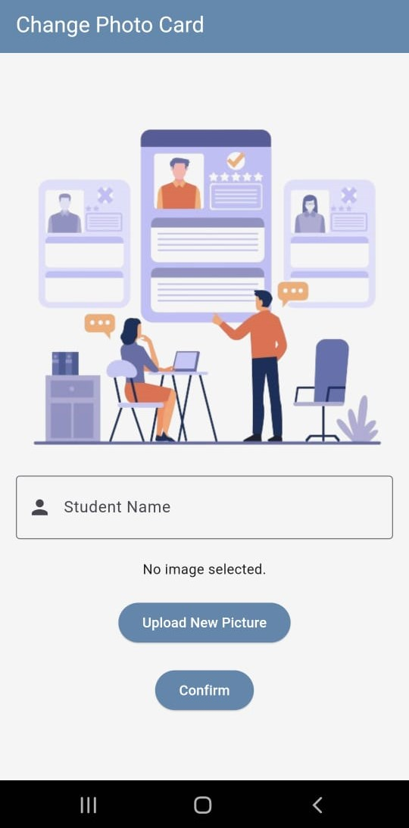
Implementation
Description:
On this page, the user can easily change his personal photo that is placed on his personal card for the college.
Change photo card
Page

Slide 50
Implementation
Description:
On this page, the user can easily change his personal photo that is placed on his personal card for the college.
Change photo card
Page

Slide 51
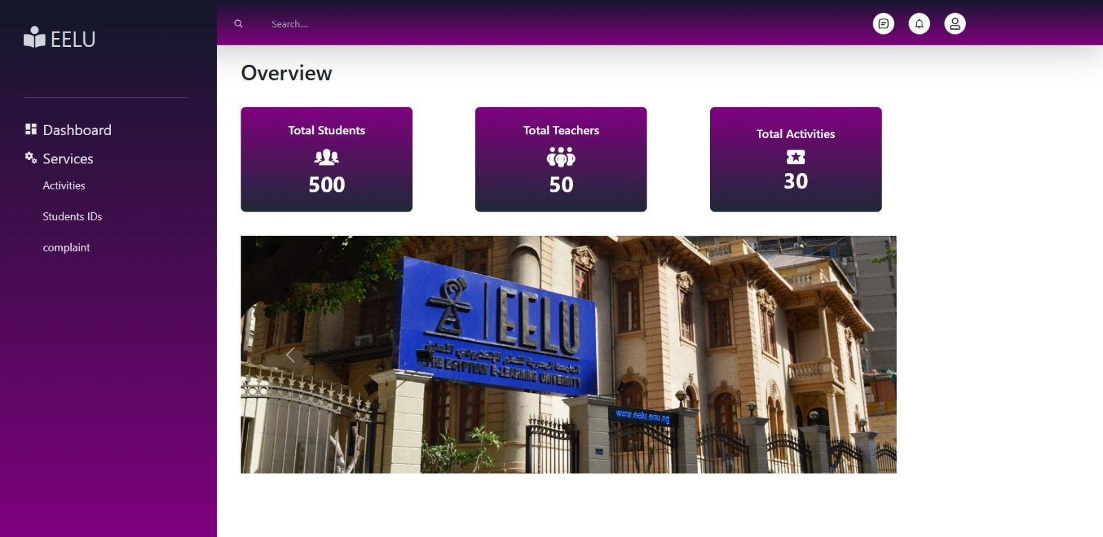
Implementation
Admin
Pages

Slide 52
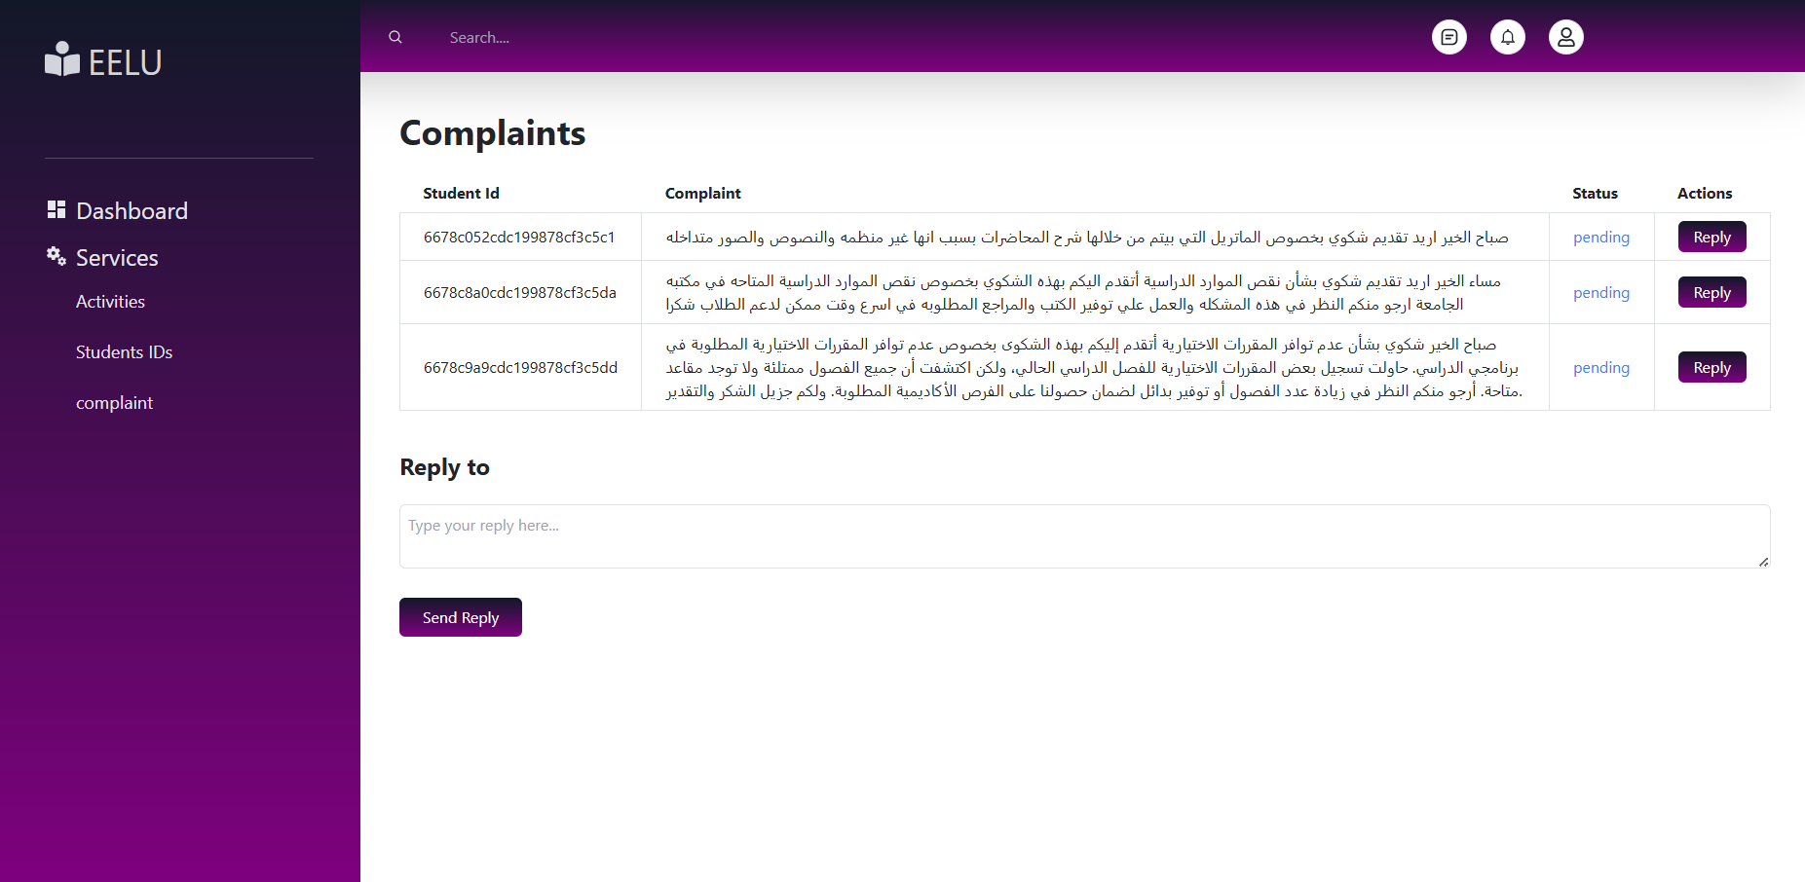
Implementation
Admin
Pages

Slide 53
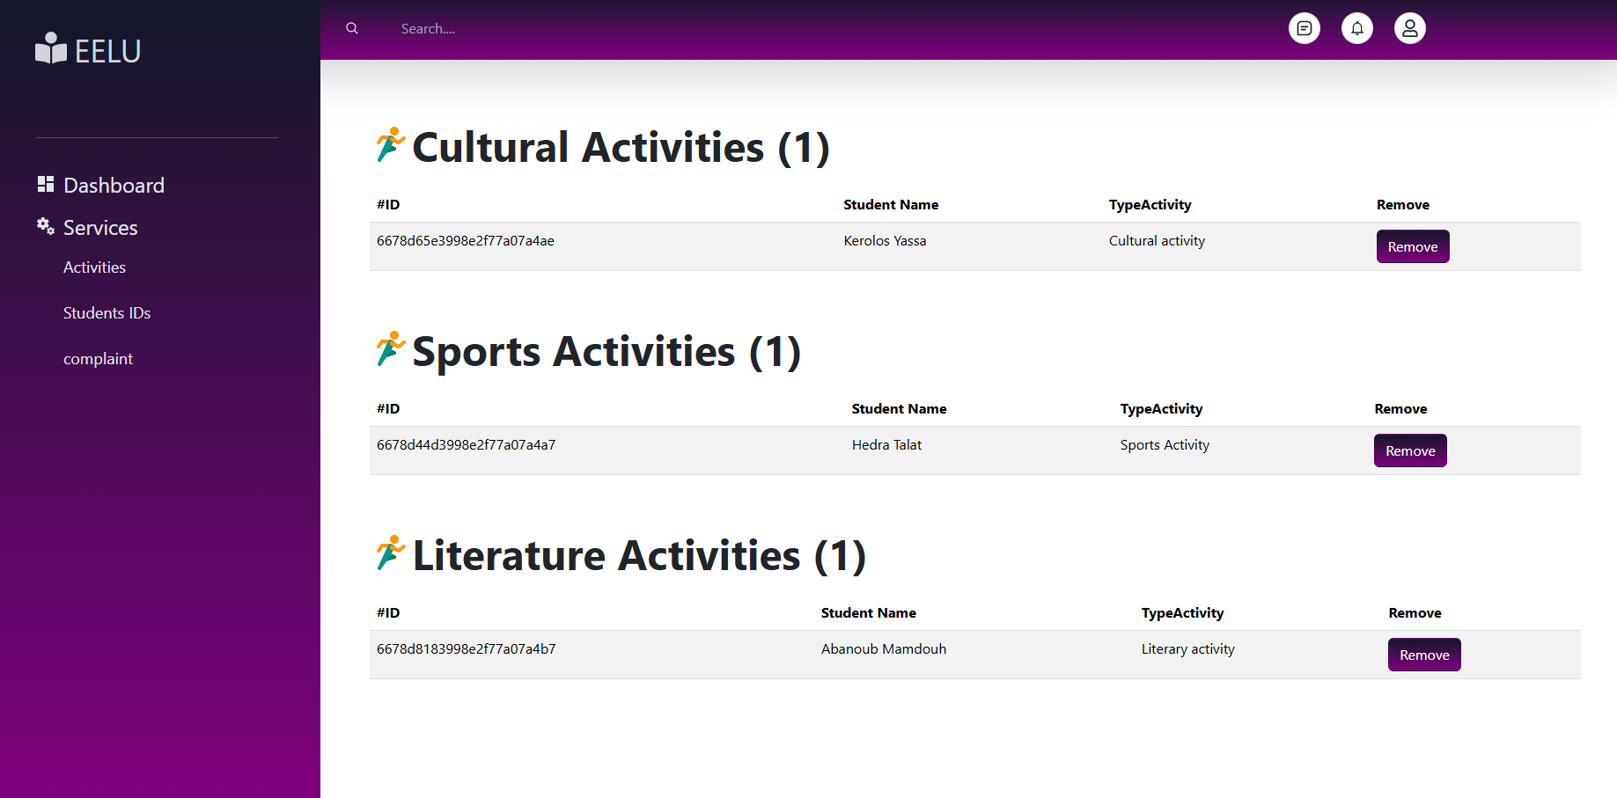
Implementation
Admin
Pages

Slide 54

Organization Report
 | DATE | TASK | Done
01 | 2-10-2023 | Choosing a team and choosing a project idea
02 | 5-11-2023 | Visiting the college affairs
03 | 20-11-2023 | Search online
04 | 25-11-2023 | Arranging and planning according to the idea and distributing tasks

Slide 55
Organization Report
 | DATE | TASK | Done
05 | 10-12-2023 | The team began working on the presentation and we identified the project's features
06 | 20-12-2023 | Choose a prototype and study it relative to the project
07 | 22-12-2023 | We want to define the features and implement them within the ERD and the Schema Diagram
08 | 25-12-2023 | We imagined the most important features of the project and began implementing them in the form of a Use case and Sequence Diagram

Slide 56
Organization Report
 | DATE | TASK | Done
09 | 2-1-2024 | One of the team members started designing user interface and user experience
10 | 10-2-2024 | One of the team members started designing and writing the code for the Front-end by flutter
11 | 16-2-2024 | One of the team members started designing and writing the code for the Back-end by Node.js
12 | 25-12-2023 | One of the team members started designing and writing Database with Mongo db

Slide 57
Organization Report
 | DATE | TASK | Done
13 | 30-1-2024 | Presentation of system To explain all the features of the project and its benefits to users
14 | 10-5-2024 | Beginning to link the front codes with the back codes with the database
15 | 11-6-2024 | Project documentation To explain all the features of the project and its benefits to users
16 | 20-6-2024 | Test the application and solve all errors that were discovered

Slide 58


